Slide 1
Basic Principles and Components of PCR
I-5-

Slide 2

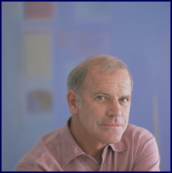
DATING IS HEALTHY FOR NAME AND FAME
Unusual Origin of PCR, Mullis KB, Scientific American 1990,56

Slide 3
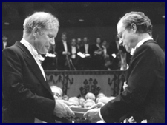
Development/Invention of PCR Technique
1993 Nobel Prize in Chemistry

Slide 4
PCR: Polymerase Chain Reaction
A method of in vitro cloning
Allows amplification of specific DNA molecules (fragments) in vitro through cycles of enzymatic DNA synthesis
The most popular and widely used technique in all fields of biological studies probably.
To amplify a lot of double-stranded DNA molecules (fragments) with same (identical) size and sequence by enzymatic method and cycling condition.
Why?

Slide 5
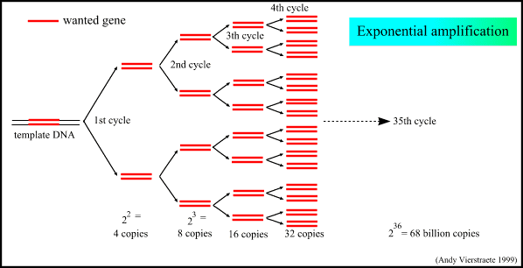
PCR
Notes:
As the previous two slides illustrated, the many feature of the PCR process is the replication of one double-strand DNA molecule into two. But the PCR process does not involve just a single replication cycle. Rather, the step is repeated many times (35-50 times). This repetition leads to an exponential increase in the amount of DNA. At the end, a large amount of DNA is produced that can be used for a number of purposes.
One of those purposes, and the one we are interested with here, is the development of a DNA probe. Remember that we started with a protein sequence of interest, and we used that information to design primers to amplify a DNA fragment that would encode that fragment. Therefore at the end of the PCR replication, we have sufficient DNA to use as a probe for library screening.

Slide 6
PRC diagnostics
Viruses
  HIV, SARS, H5N1
Bacteria
  meningococcus, legionellosis
Analysis for resistant genes
  MRSA, VRE

Slide 7
Steps in PCR
1. Denaturation of ds DNA template
2. Annealing of primers
3. Extension of ds DNA molecules

Slide 8
Denaturation:
Open two strands of DNA from each other
Boil DNA at 95 degrees for 2 minutes
Annealing
Hybridize
Primers anneal to denatured template DNA
Annealing temperature 50-55 degrees
Extension
DNA polymerase synthesizes (polymerizes) new DNA molecule by adding deoxyribonucleoside complementary to the corresponding template base in a 5’ to 3’ direction at 68-72 degrees.

Slide 9
CONSTITUENTS of PCR
Enzyme
Buffers and MgCl₂
Deoxynucleoside triphosphates (dNTPs
Template DNA
Primers

Slide 10
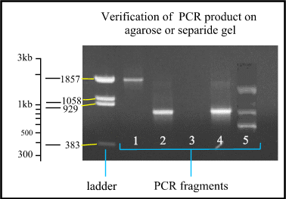
PCR Analysis on Agarose Gel Electrophoresis

Slide 11
PRC diagnostics
Viruses
  HIV, SARS, H5N1
Bacteria
  meningococcus, legionellosis
Analysis for resistant genes
  MRSA, VRE

Slide 12
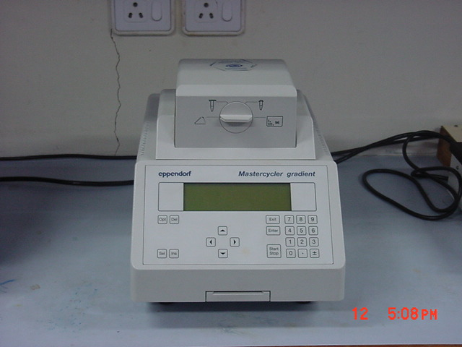
Instrumentation

